Slide 1

iX MOBILE BANKING PREDICTION.
Cohort 1 Bootcamp - Data Science Track
By
Team Techwiz

Slide 2
PROBLEM Identification
The use of mobile banking has not been efficiently utilized by bank customers and this has resulted in over crowded banking halls, risking exposure to COVID-19.
The low usage can be traced to:
Complexity of the banking application.
Limited access to banking resources (e.g. ATM cards)
Poor UI/UX
Team Techwiz is looking to increase the percentage of users who would engage in online banking activities as opposed to on-premises banking with the dataset provided by zindi.ai.
This will help improve SDG goal 1, 2, 3,4,7, because when people have access to banking facilities at all times, they invest and make wise financial decisions.
Notes:
GOAL 1: No Poverty.
GOAL 2: Zero Hunger.
GOAL 3: Good Health and Well-being.
GOAL 4: Quality Education.
GOAL 7: Affordable and Clean Energy.

Slide 3
EXPECTED SOLUTION/OUTPUT
The solution should Determine whether one has used mobile or internet banking by exploring users financial trends.
The solution should provide efficiency in banking activities as well as ease of access to account owners.
This would bring an exponential growth and safety to banking experience, especially in this post-COVID era.

Slide 4
DATA Source
Data was collected from https://zindi.africa/competitions/ix-mobile-banking-prediction-challenge/data under iX Mobile Banking Prediction Challenge.
The available data consists of :
Training data - contains 100,000 survey responses from around Africa.
Test data – contains 45,000 survey responses from around Africa.
Variable definition – contains definitions of each column in the dataset.

Slide 5

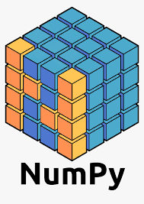



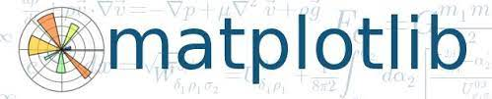
Tools and Libraries used

Slide 6
Data Wrangling
We merged the train and test data to get a unified datasets for easy access and analysis of the messy data.

Slide 7
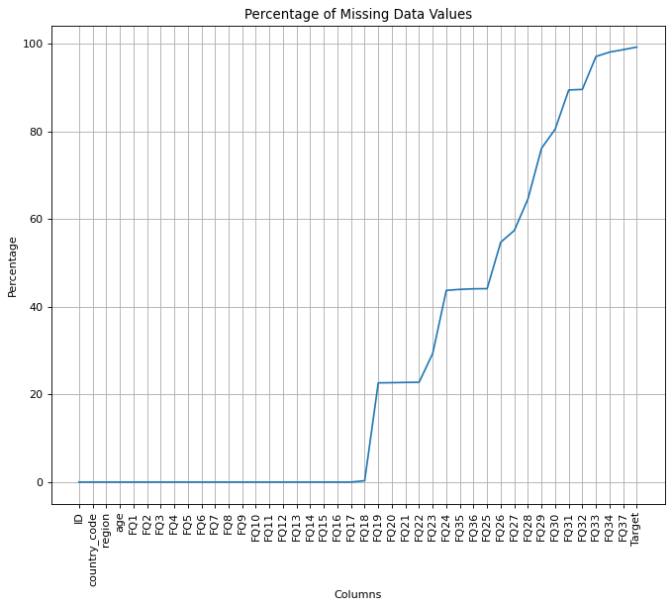
Total Missing column values

Slide 8
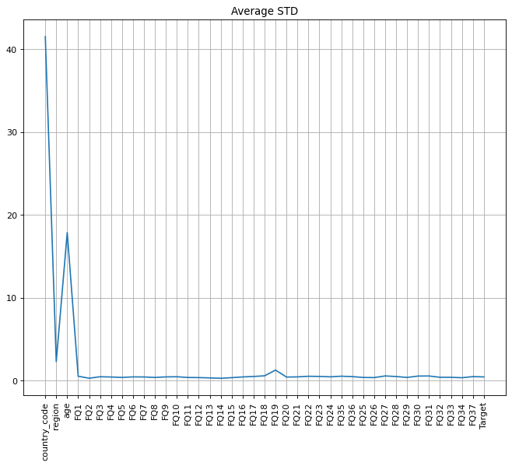
Total Average Standard Deviation

Slide 9
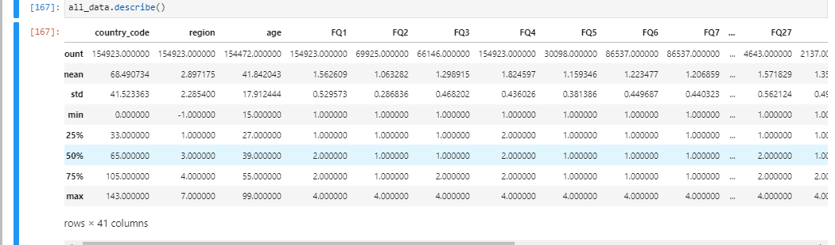
Merged data statistics before cleaning

Slide 10
Data Cleaning
We filled the missing values across columns using the mean or median depending on column variable.

Slide 11
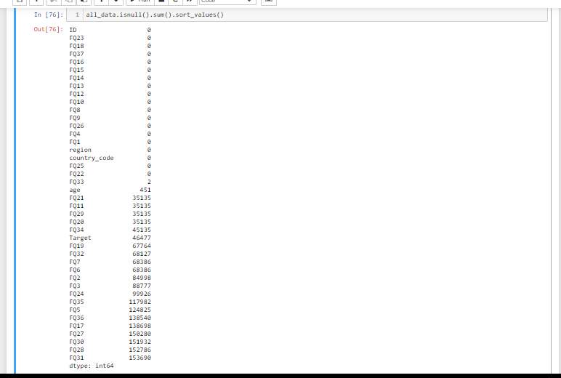
Before cleaning

Slide 12
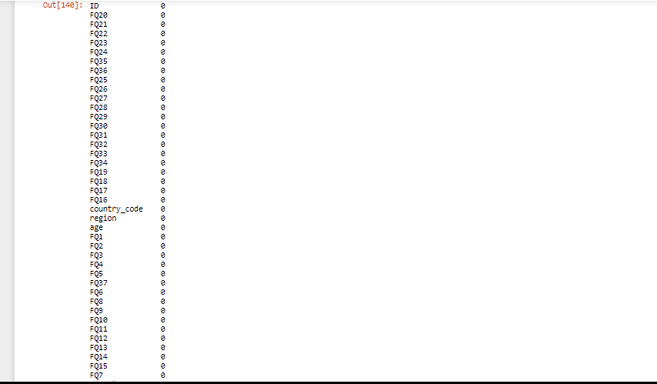
After cleaning

Slide 13
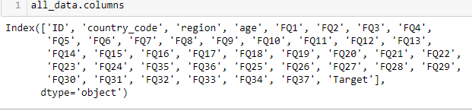
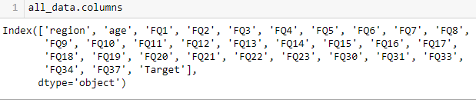
EXPLORATORY DATA ANALYSIS(EDA)
Before the EDA process, we dropped some columns to avoid data redundancy.
E.g. either of country code or region can be used for the same analysis.

Slide 14
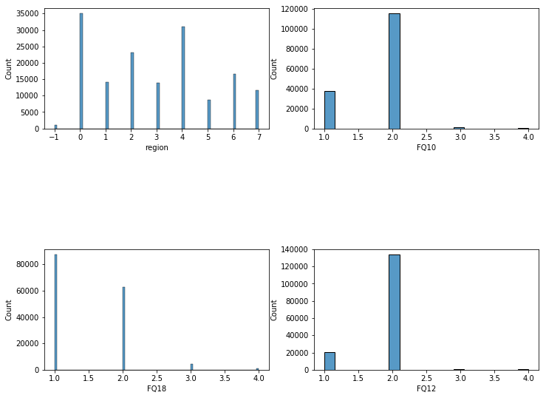
Has a Means of earning Income
Notes:
FQ10 -. Saved the money at a bank/financial institutions
FQ18 -> What is the possibility of coming up with 1/20 of per capita in 1 month
FQ12 -> Has a loan from formal financial institutions to purchase land, home, or apartment
FQ10 -> Saved the money at a bank/financial institutions

Slide 15
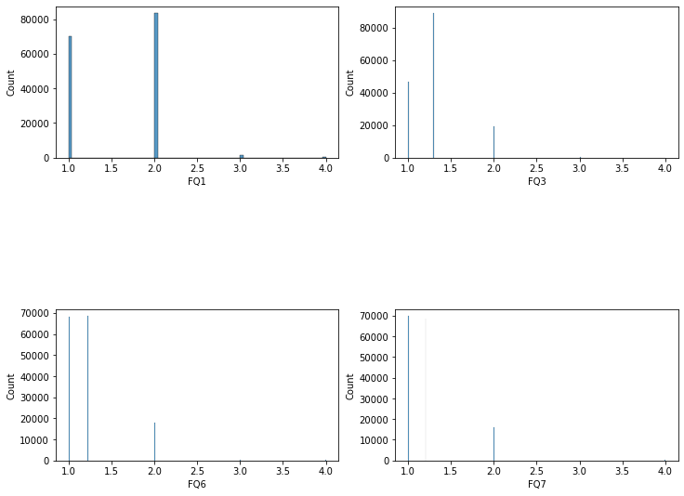
Performs Regular banking transactions
Notes:
FQ1 -> Has ATM/debit card
FQ3 -> Purchased with the ATM
FQ6 -> Money deposits to a bank account in the last 12 months
FQ7 -> Money withdrawals from a bank account in the last 12 months

Slide 16
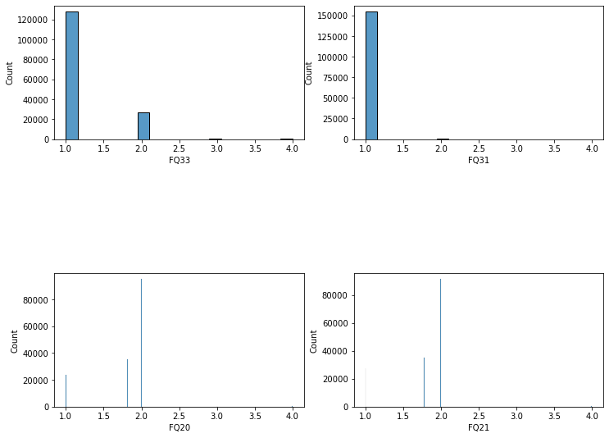
Performs Mobile Banking
Notes:
FQ33 -> Owns a mobile phone
FQ31 -> Did you open the a/c to receive payments in FQ29
FQ20 -> Sent/given money to friend/relative
FQ21 -> Received money from friend or relative

Slide 17
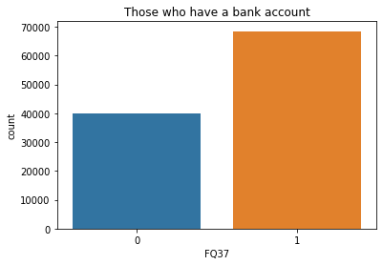
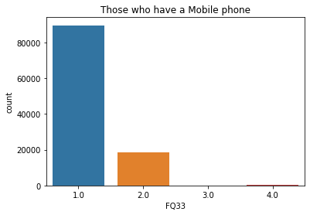
Has a bank account vs don’t have
Notes:
Where 0 and 1.0 = don’t have FQ37 ->Owns a bank a/c
1 and 2.0 = have FQ33 -> Owns a mobile phone

Slide 18
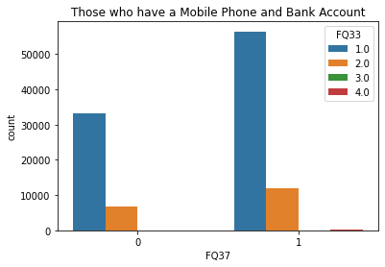
Has a bank account and performs mobile banking vs don’t
Notes:
Where 0 = don’t have FQ37 ->Owns a bank a/c
1 = have FQ33 -> Owns a mobile phone

Slide 19
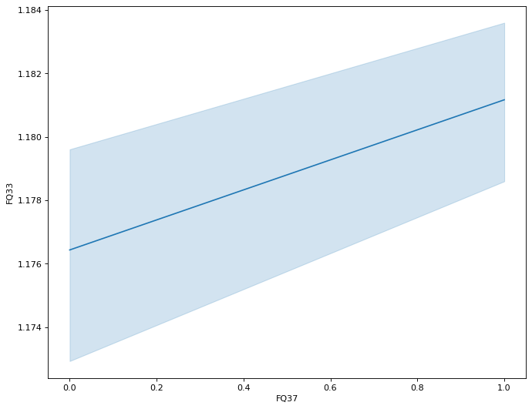
Variance of having a bank account and a mobile phone

Slide 20
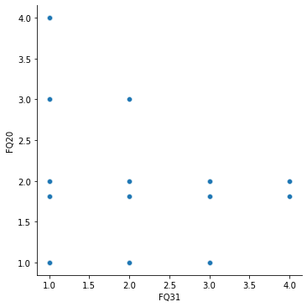
Has an active Bank Account
Notes:
FQ20 -> Sent/given money to friend/relative
FQ31 -> Did you open the a/c to receive payments in FQ29
FQ29 -> Received money for the sale of livestock, agricultural products, crops, produce? (12 months)

Slide 21
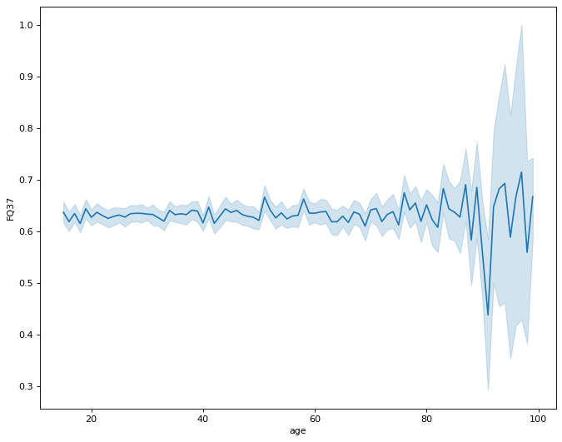
Age range of those with a bank account

Slide 22
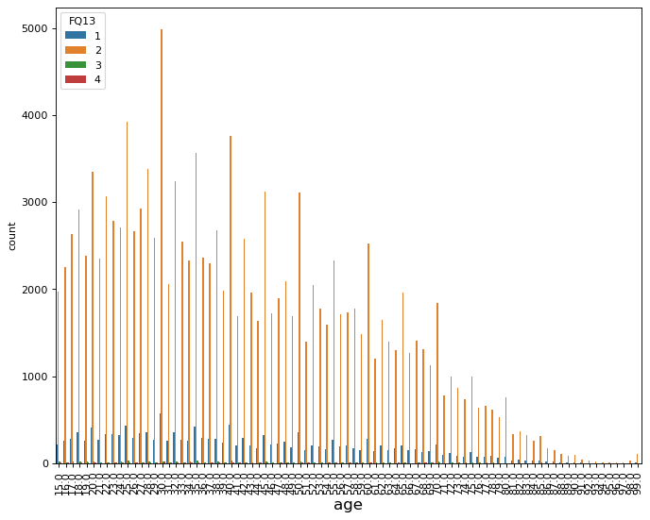
Borrowed money
Notes:
Borrowed money for health/medical purposes in the last 12 months
Borrowed money to start/grow business or farm
Borrowed money from friends, relatives, or family - 12 months
Borrowed money from formal financial institutions - 12 months

Slide 23
Pre-processing and Training Data Development
We used OneHotEnoding by implementing dummy variables for Feature Engineering.
This option converted our categorical variables into binary values while making sure higher numbers were not assumed to be more important.
Then we split the dataset into training data and testing data.

Slide 24
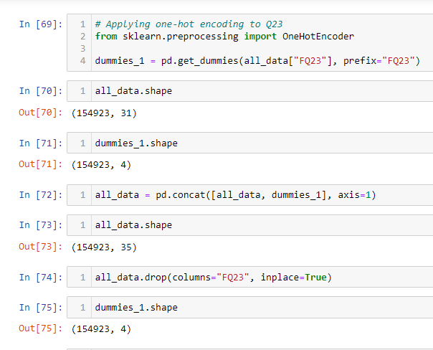
Change In data shape

Slide 25
MODELLING
Since this is a classification problem, we used four different classification algorithms:
Naïve Bayes GaussianNB classifier
Random Forest Classifier
Decision Tree Classifier
Support Vector Machine
To be able to access these algorithm, we had to import the scikit learn library, a ML library for predictive data analysis.

Slide 26
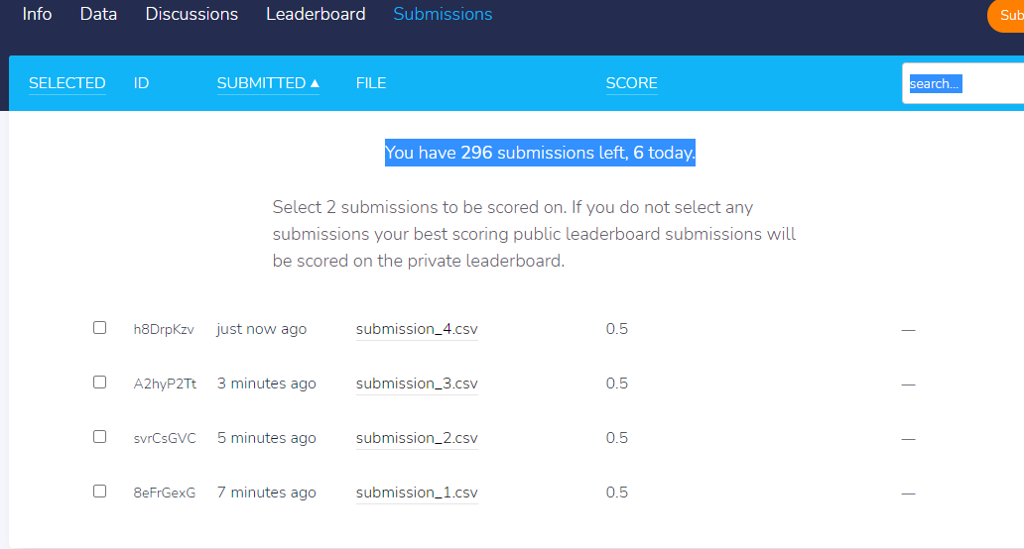
DEPLOYMENT
To test our accuracy score, we deployed our codes on zindi.ai

Slide 27
Zindi scores
ALGORITHM | SCORE
Naïve Bayes Gaussian | 0.5
Random Forest Classifier | 0.5
Decision Tree Classifier | 0.5
Support Vector Machine Classifier | 0.5

Slide 28
Conclusion
With prediction measurement being between 0 and 1 and our score on zindi.ai leaderboard being 0.5.
We can confidently say that our prediction is 50% accurate.

Slide 29
Thank you for listening…

